Slide 1
High Performance and Distributed Computing for Big Data
Unit 3: AWS - Lambda
Ferran Aran Domingo ferran.aran@udl.cat
Universitat Rovira i Virgili and Universitat de Lleida

Slide 2
Cloud functions

Slide 3
Cloud functions
Cloud functions enable serverless computing, allowing developers to run code without provisioning or managing servers.

Slide 4
Cloud functions
Cloud functions enable serverless computing, allowing developers to run code without provisioning or managing servers.
Example
Automatically processing patient data uploads, triggering real-time alerts, and updating medical
dashboards without infrastructure management.

Slide 5
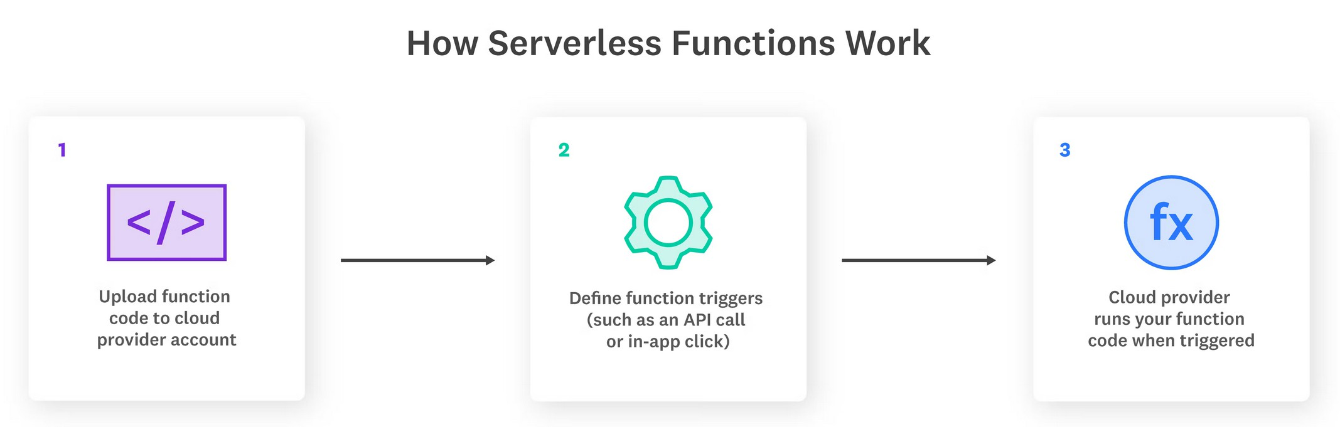
Serverless?
Figure 1: Serverless model

Slide 6
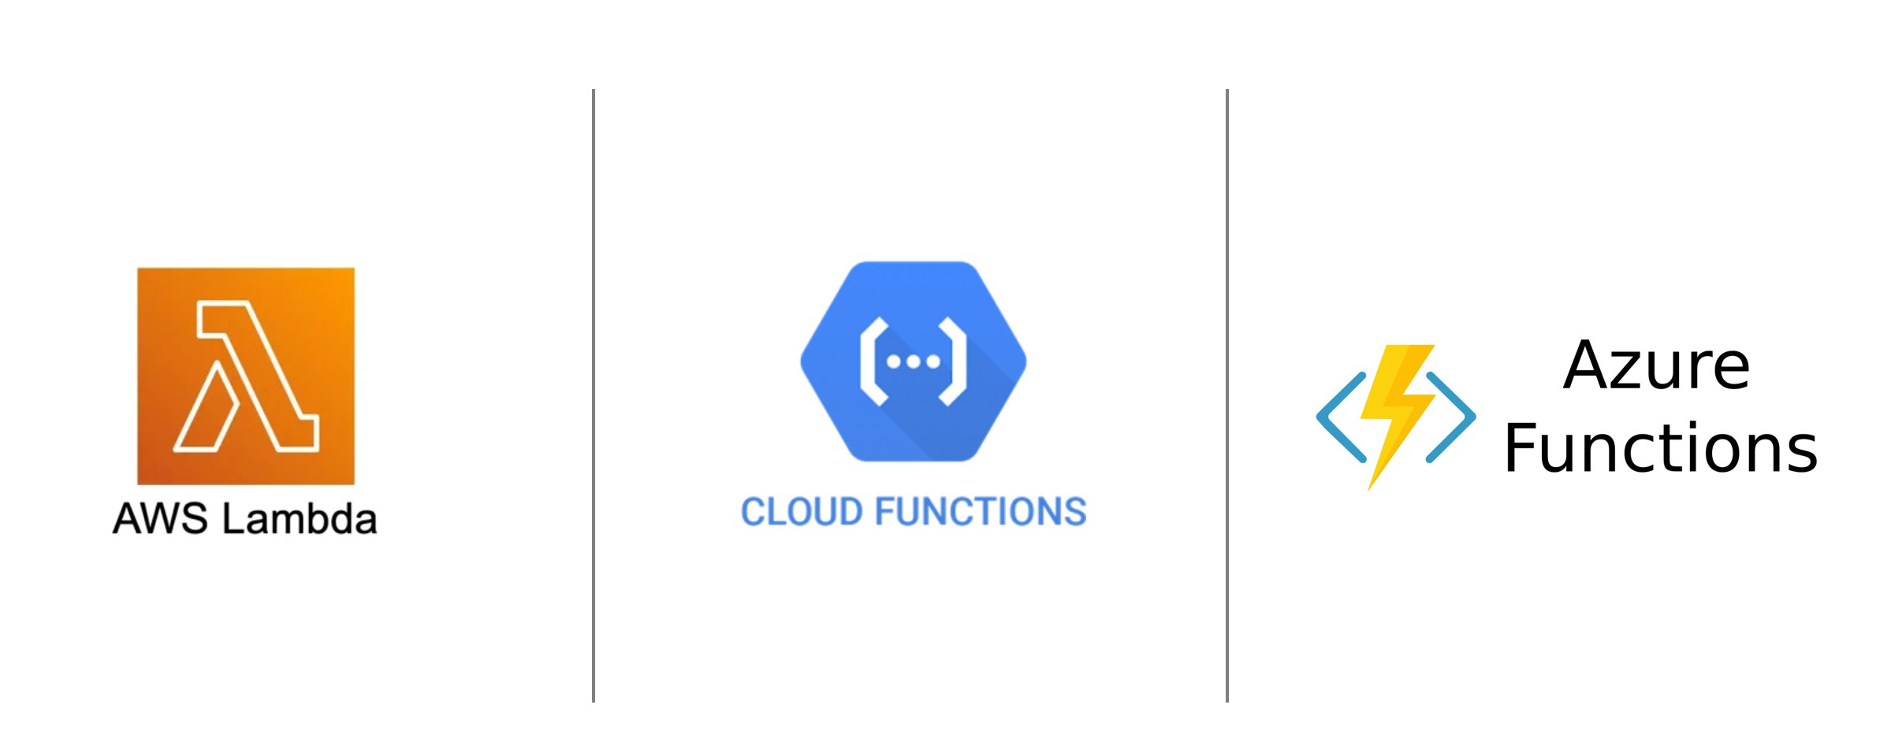
Providers
Figure 2: Serverless providers

Slide 7
AWS Lambda

Slide 8
Introduction to AWS Lambda
What is AWS Lambda?
Event-driven, serverless computing service.
Runs code in response to triggers.

Slide 9
Introduction to AWS Lambda
What is AWS Lambda?
Event-driven, serverless computing service.
Runs code in response to triggers.
Key benefits
Automatic scaling and high availability.
Pay-per-use billing model.

Slide 10
Introduction to AWS Lambda
What is AWS Lambda?
Common use cases
Event-driven, serverless computing service.
Runs code in response to triggers.
Real-time file processing (e.g., medical imaging).
Backend for web and mobile health applications.
Key benefits
Automatic scaling and high availability.
Pay-per-use billing model.

Slide 11
Introduction to AWS Lambda
What is AWS Lambda?
Common use cases
Event-driven, serverless computing service.
Runs code in response to triggers.
Real-time file processing (e.g., medical imaging).
Backend for web and mobile health applications.
Key benefits
Automatic scaling and high availability.
Pay-per-use billing model.
Supported languages
Python, Node.js, Java, Go, Ruby, .NET, and more.

Slide 12
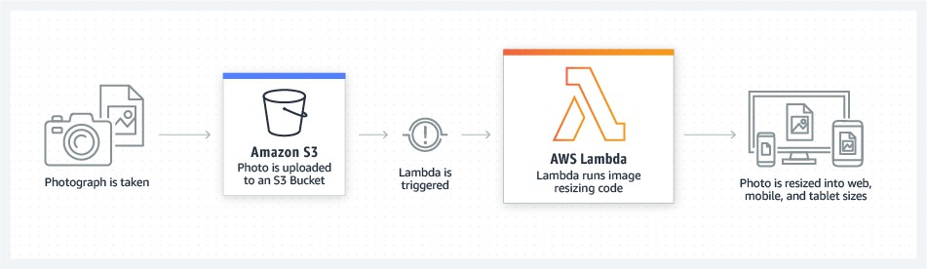
AWS Lambda architecture overview
Figure 3: Lambda Architecture

Slide 13
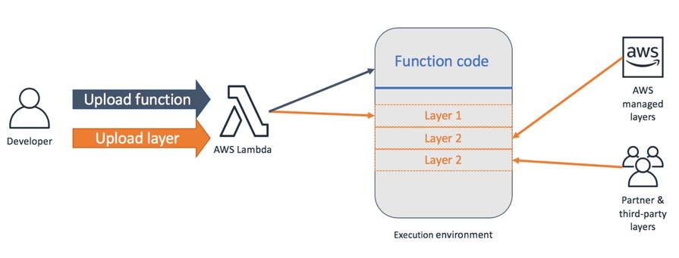
AWS Lambda architecture overview
Figure 4: Lambda Architecture

Slide 14
AWS Lambda architecture overview
Core components
Code (Function)
Layers (Dependencies)
Event Sources (S3, API Gateway, CloudWatch, etc.)
Event-driven execution
Code executes in response to events.
Easily integrates with other AWS services.

Slide 15
AWS Lambda architecture overview
Core components
Code (Function)
Layers (Dependencies)
Event Sources (S3, API Gateway, CloudWatch, etc.)
Event-driven execution
Code executes in response to events.
Easily integrates with other AWS services.
Did you know? AWS Lambda functions have a maxi- mum execution time limit of 15 minutes per invocation.

Slide 16
How AWS Lambda compares to EC2
AWS EC2
Full control over infrastructure (turn it on/off, upgrading).
Manual scalability management (want more? You have to add more).
Fixed cost for uptime.

Slide 17
How AWS Lambda compares to EC2
AWS EC2
AWS Lambda
Full control over infrastructure (turn it on/off, upgrading).
Manual scalability management (want more? You have to add more).
Fixed cost for uptime.
No infrastructure management (serverless).
Automatic scalability (from zero to thousands).
Pay for actual execution time.

Slide 18
Use cases for AWS Lambda
Real-time data processing: Lambda can analyze sensor data from wearable devices to identify irregular patterns.

Slide 19
Use cases for AWS Lambda
Real-time data processing: Lambda can analyze sensor data from wearable devices to identify irregular patterns.
Data aggregation: Lambda can collect data from multiple clinical trial sites, aggregating information on patient outcomes, adverse events, and treatment eﬀicacy preparing a dashboard for the researchers.

Slide 20
Use cases for AWS Lambda
Real-time data processing: Lambda can analyze sensor data from wearable devices to identify irregular patterns.
Data aggregation: Lambda can collect data from multiple clinical trial sites, aggregating information on patient outcomes, adverse events, and treatment eﬀicacy preparing a dashboard for the researchers.
Data validation: Lambda can validate lab results (such as blood tests) by checking for outliers or inconsistencies. For example, abnormal values outside the expected range may require further investigation. Alerts can be sent to the lab technician or the patient’s healthcare provider.

Slide 21
Use cases for AWS Lambda
Real-time data processing: Lambda can analyze sensor data from wearable devices to identify irregular patterns.
Data aggregation: Lambda can collect data from multiple clinical trial sites, aggregating information on patient outcomes, adverse events, and treatment eﬀicacy preparing a dashboard for the researchers.
Data validation: Lambda can validate lab results (such as blood tests) by checking for outliers or inconsistencies. For example, abnormal values outside the expected range may require further investigation. Alerts can be sent to the lab technician or the patient’s healthcare provider.
Image processing: Lambda can process images to identify patterns or anomalies.

Slide 22
Example: Counting cells at scale
Scenario
Imagine a lab that generates a large collection of cell images every time they run an experiment. Once the experiment is done, they want to know the number of cells in each image to analyze the results but they want this process to be automated and immediate.

Slide 23
Example: Counting cells at scale
Scenario
Imagine a lab that generates a large collection of cell images every time they run an experiment. Once the experiment is done, they want to know the number of cells in each image to analyze the results but they want this process to be automated and immediate.
Workflow
1. A lab uploads a collection of cell images to S3.

Slide 24
Example: Counting cells at scale
Scenario
Imagine a lab that generates a large collection of cell images every time they run an experiment. Once the experiment is done, they want to know the number of cells in each image to analyze the results but they want this process to be automated and immediate.
Workflow
A lab uploads a collection of cell images to S3.
S3 events trigger Lambda functions (one event per image, one function per event).

Slide 25
Example: Counting cells at scale
Scenario
Imagine a lab that generates a large collection of cell images every time they run an experiment. Once the experiment is done, they want to know the number of cells in each image to analyze the results but they want this process to be automated and immediate.
Workflow
A lab uploads a collection of cell images to S3.
S3 events trigger Lambda functions (one event per image, one function per event).
Lambda functions process the images and count the cells.

Slide 26
Example: Counting cells at scale
Scenario
Imagine a lab that generates a large collection of cell images every time they run an experiment. Once the experiment is done, they want to know the number of cells in each image to analyze the results but they want this process to be automated and immediate.
Workflow
A lab uploads a collection of cell images to S3.
S3 events trigger Lambda functions (one event per image, one function per event).
Lambda functions process the images and count the cells.
Results are stored in S3.

Slide 27
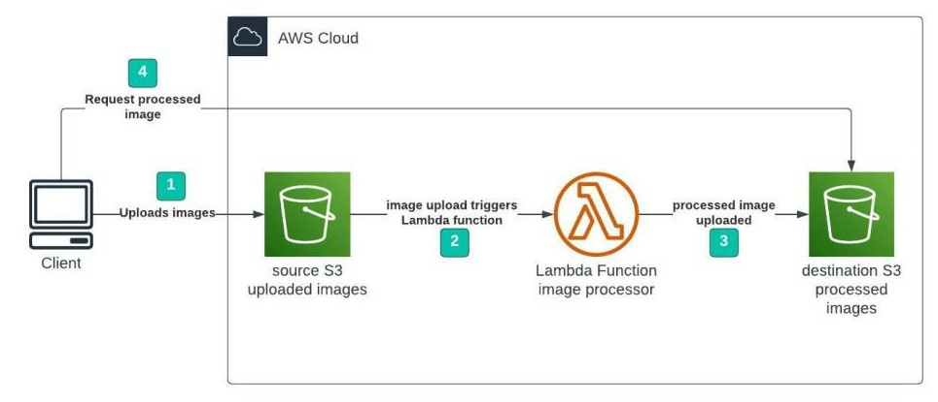
Example: Counting cells at scale
Figure 5: Health Data Flow

Slide 28
Lab: Counting cells at scale

Slide 29
Outline
Pre-requisites
A machine with AWS Credentials configured and Python 3.13 installed. (I am going to use the EC2 instance we created in the previous unit together with uv for managing python versions).
The cell images downloaded and extracted, find them here https://campusvirtual.urv.cat/ or on the subject’s website https://hdbc-17705110-mdbs.github.io.
Goal
Upload a collection of cell images to an S3 bucket and trigger a Lambda function to count the cells in each image. The lambda will store the results in another S3 bucket.

Slide 30
Outline
Steps
Create the buckets.
Create the Lambda function.
Add a trigger to the Lambda function.
Write the Lambda function code.
Create and publish a Lambda layer with the dependencies.
Upload the images to the input bucket.
Check the results in the output bucket and verify the Lambda logs.

Slide 31
Step 1: Create the buckets
As we did in the previous session, we are going to visit the S3 service in the AWS console and create two buckets, one for the input images and another for the output results. Leave everything as default and just set the name for each one as shown below:
Input bucket: medical-images-raw-[YOUR-NAME]
Output bucket: medical-images-processed-[YOUR-NAME]
In my case that will be medical-images-raw-ferran-aran and
medical-images-processed-ferran-aran.
S3 Bucket names
Remember S3 bucket names must be unique across all AWS accounts. If you get an error when
creating the bucket, try a different name (e.g., add a random number at the end).

Slide 32
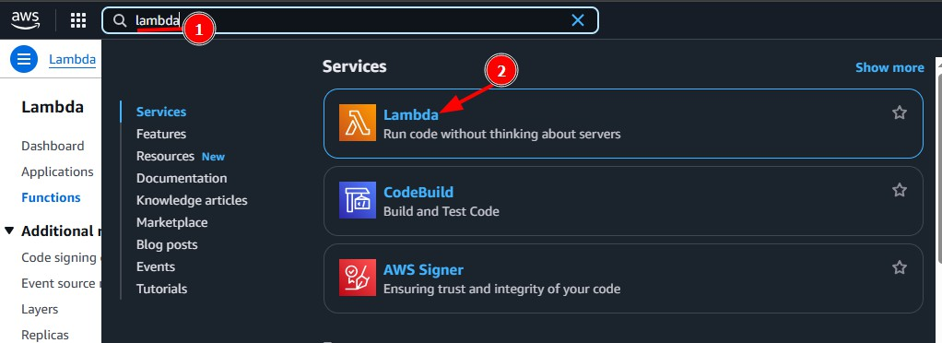
Step 2: Create the Lambda function
We are going to search for lambda in the AWS Console as usual and click on the first result.
Figure 6: Lambda search

Slide 33
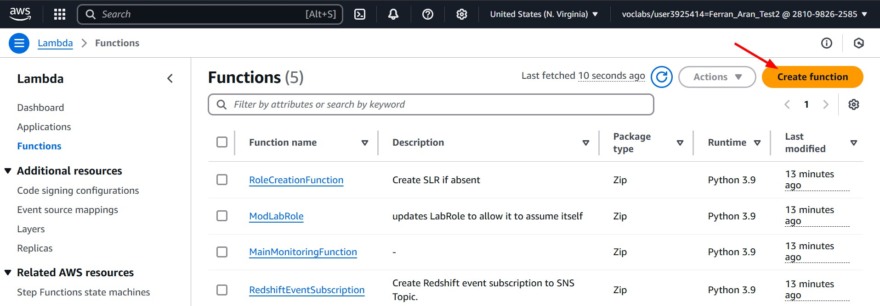
Step 2: Create the Lambda function
Now click on create function.
Figure 7: Create function

Slide 34
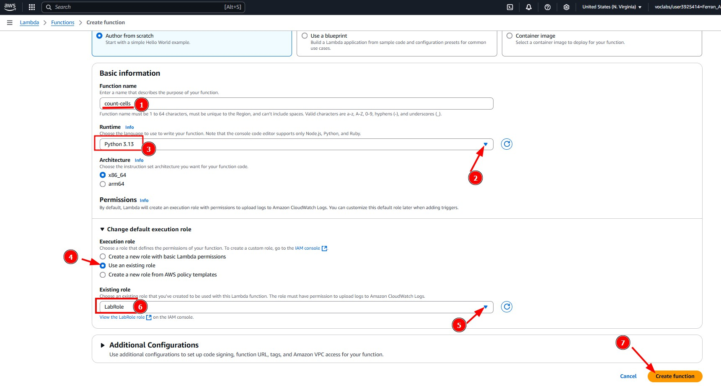
Step 2: Create the Lambda function
And fill the form like shown below (the function name doesn’t matter but I suggest you use
count-cells):
Figure 8: Create function

Slide 35
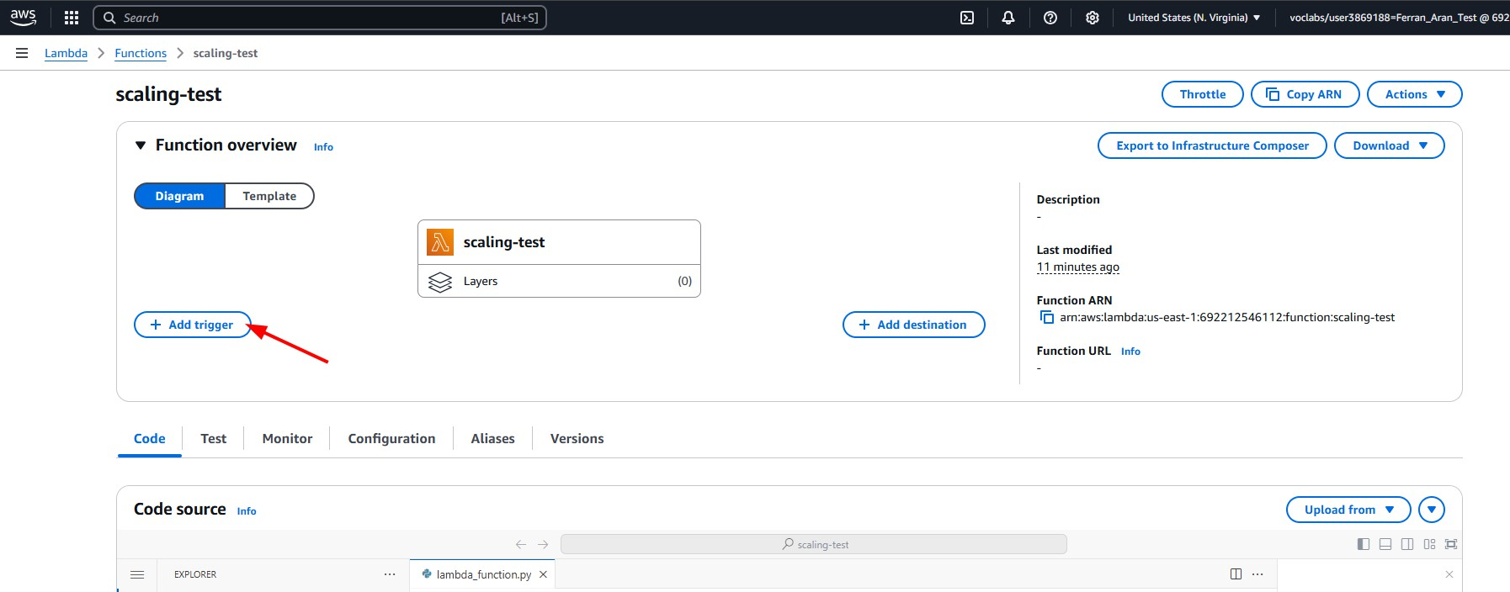
Step 3: Add a trigger to the Lambda function
If we want our Lambda function to be executed when a new image is uploaded to the input bucket, we need to add a trigger. Click on the + Add trigger button.
Figure 9: Add trigger

Slide 36
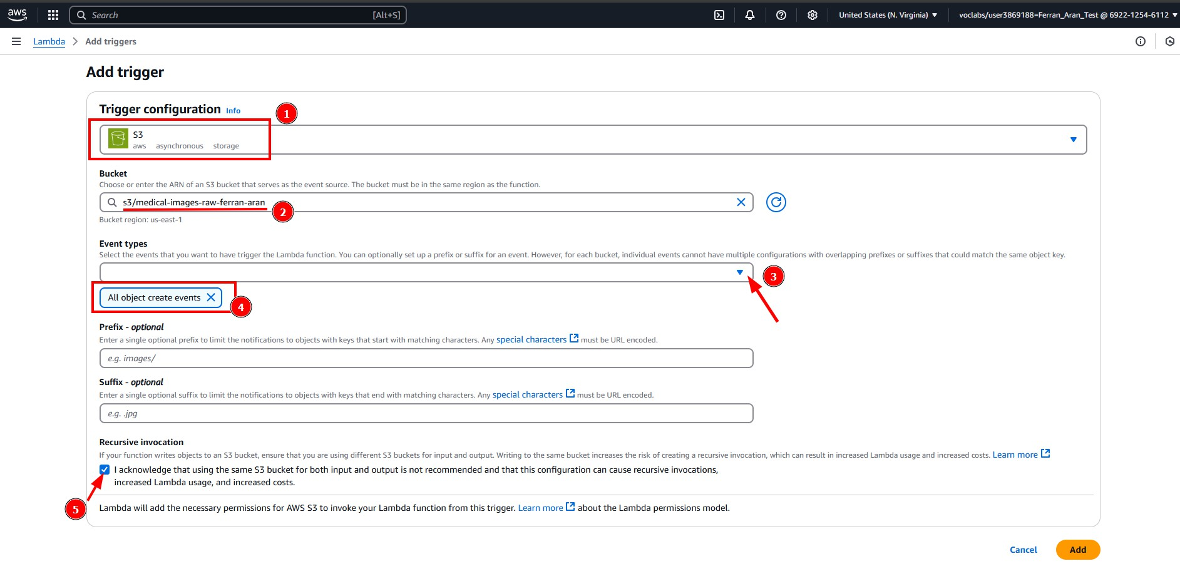
Step 3: Add a trigger to the Lambda function
Start by searching for S3 in the trigger configuration and then fill in the form like shown below:
Figure 10: Add trigger

Slide 37
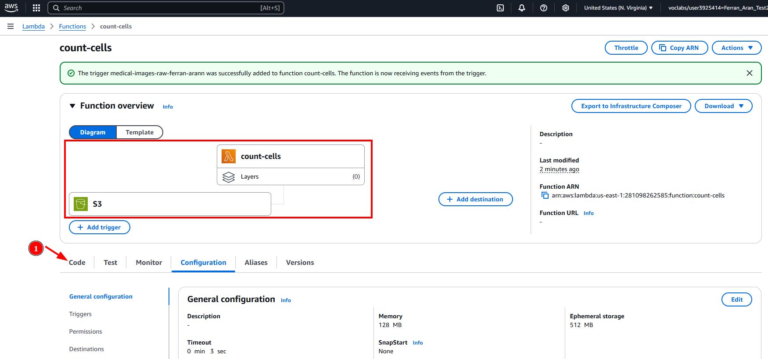
Step 3: Add a trigger to the lambda function
Okay so we’ve now configured our lambda to be triggered when a new object is created in the input bucket. But how do we access the image in the bucket from the lambda function?
Since we have configured the trigger to be an S3 event, AWS is going to send a JSON object to the lambda function with the information about the event.
Go back to the code tab as shown below.
Figure 11: Code tab

Slide 38
Step 3: Add a trigger to the lambda function
Take a look at the default code that came with our lambda function:
import json
def lambda_handler(event, context):
# TODO implement
return {
'statusCode': 200,
'body': json.dumps('Hello from Lambda!')
}
This is the basic structure of a lambda function. The lambda_handler function is the entry point of the lambda and it receives two arguments: event and context. The event argument is the JSON object we were talking about that contains the information about the event that triggered the lambda. So anything we want to do with our lambda function has to be done inside this function.

Slide 39
Step 3: Add a trigger to the lambda function
Let’s see how the event looks like by printing it:
import json
def lambda_handler(event, context): print(json.dumps(event, indent=2)) return {
'statusCode': 200,
'body': json.dumps('Hello from Lambda!')
}

Slide 40
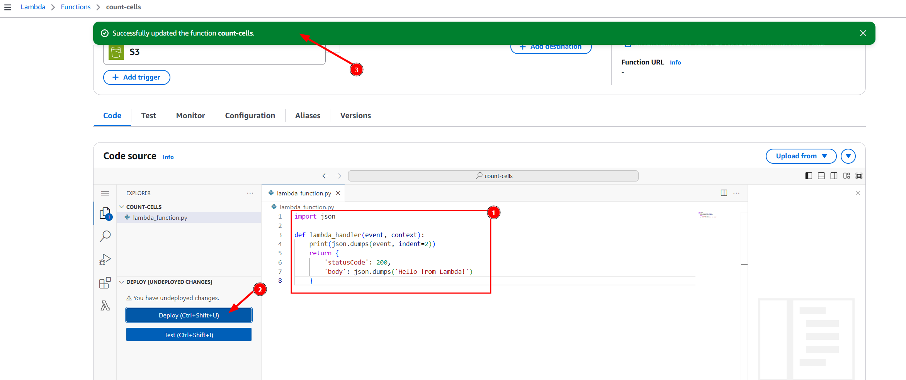
Step 3: Add a trigger to the lambda function
Once we are happy with the code, we need to “save” the changes by clicking on the Deploy button as shown below.
Figure 12: Deploy

Slide 41
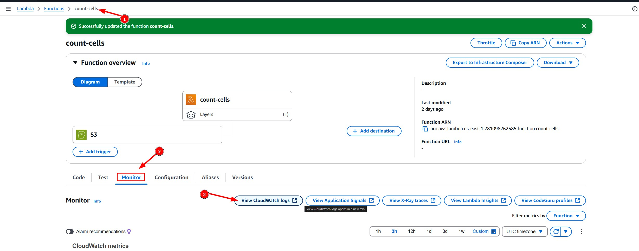
Step 3: Add a trigger to the lambda function
Now we have to trigger the lambda function by uploading an image to the input bucket. You can do this by visiting the S3 service in the AWS Console and clicking on the input bucket
medical-images-raw-[YOUR-NAME] we created earlier. Then click on Upload and select an image to upload.
We can now go back our lambda, click on Monitoring and then on View logs in CloudWatch to see the logs of the lambda function.
Figure 13: CloudWatch logs

Slide 42
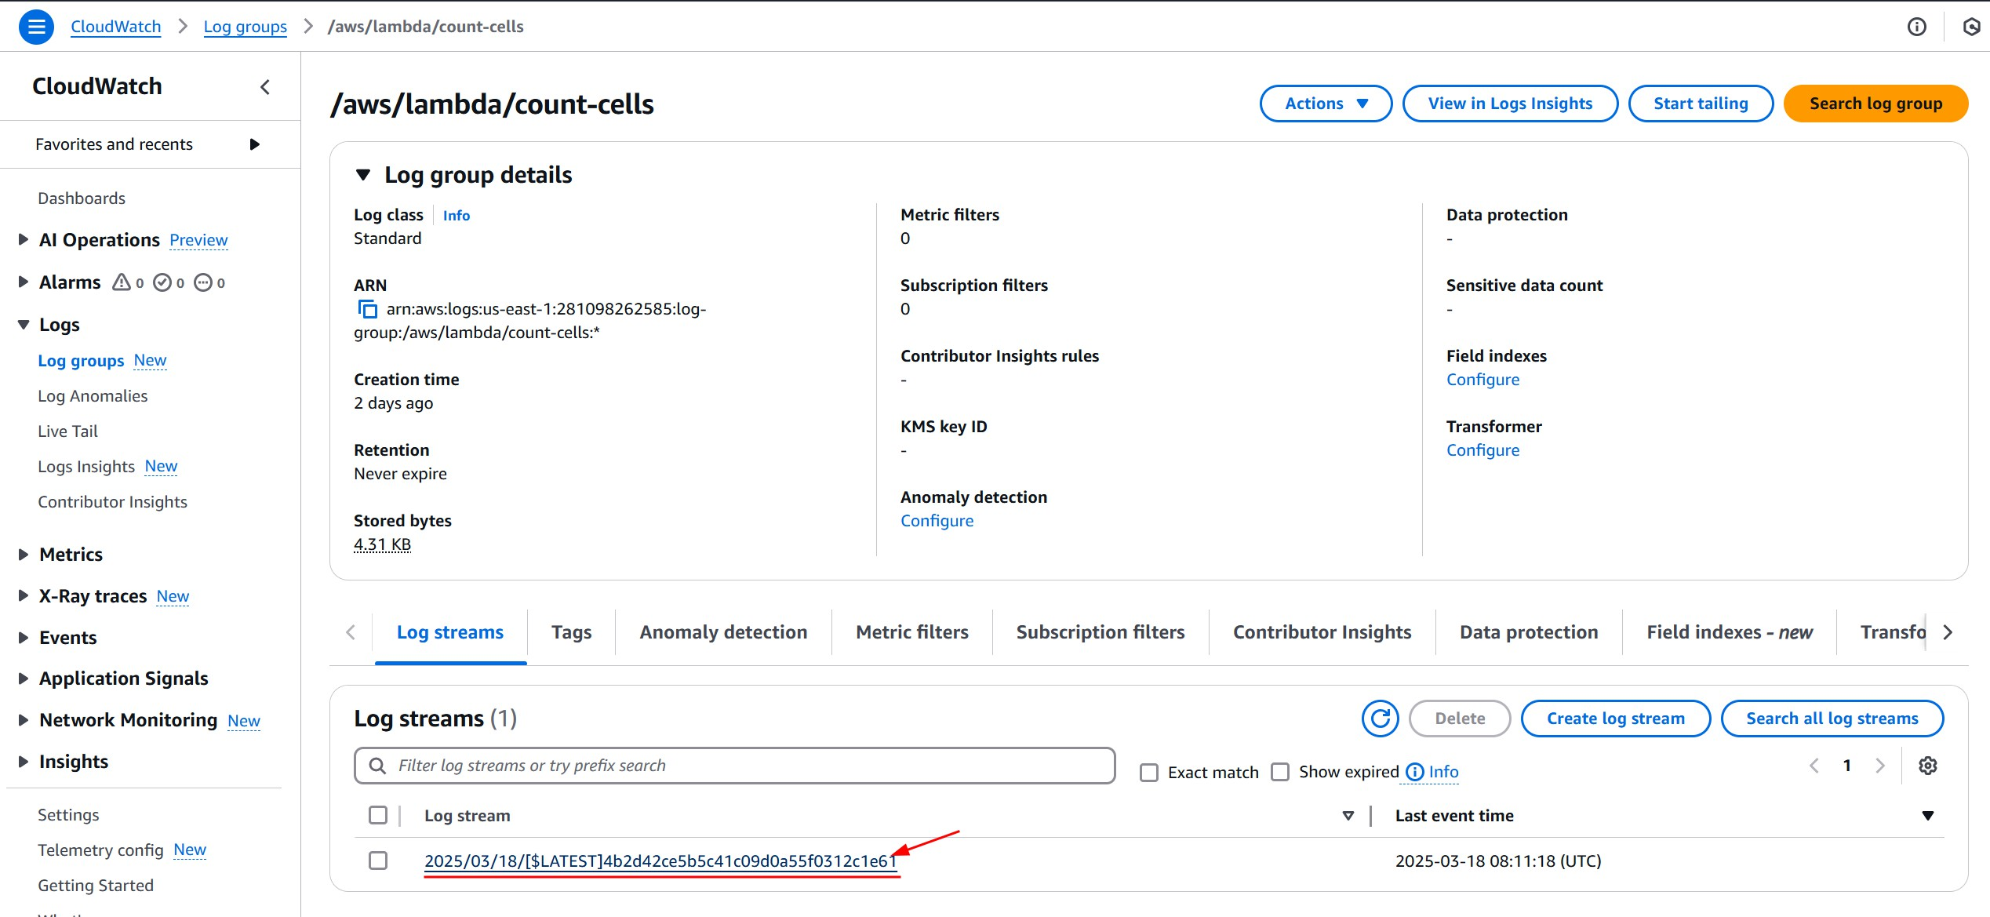
Step 3: Add a trigger to the lambda function
Click on the latest log stream to see the logs of the lambda function.
Figure 14: CloudWatch logs

Slide 43
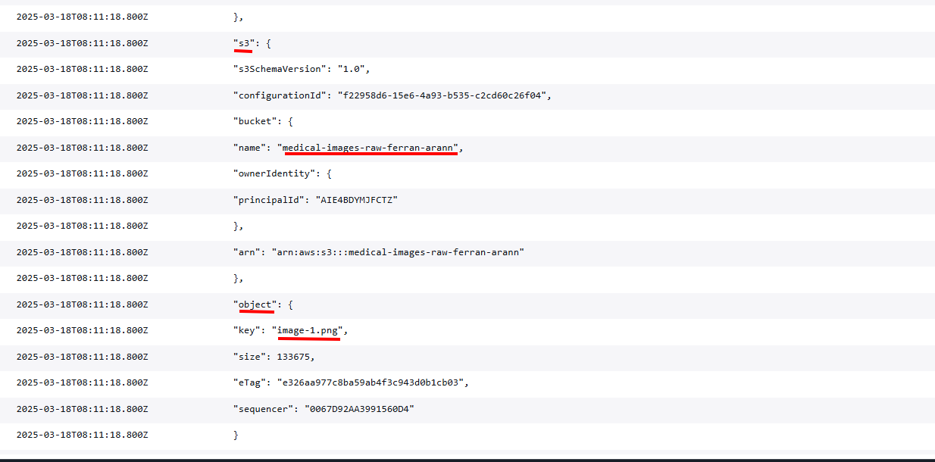
Step 3: Add a trigger to the lambda function
If everything went well you should see the event printed in the logs in the form of a JSON. There is lots of information but we are just interested in a couple of fields; the S3 bucket name and the object key.
Figure 15: CloudWatch logs

Slide 44
Step 3: Add a trigger to the lambda function
Okay now that we know we have the information we need to access the image in the S3 bucket, we can write some template code that accesses the image on the bucket that triggered the lambda and saves it to the processed bucket.
We’ll be using the boto3 library to interact with S3 as we did in the previous session. Go back to your lambda function on the “Code” tab and paste the following code. Remember to change the bucket name (note that the code takes 2 slides to fit):
import boto3 import json import os
import urllib.parse
s3 = boto3.client('s3')

Slide 45
Step 3: Add a trigger to the lambda function
def lambda_handler(event, context):
# Extract bucket and image info from the S3 event
bucket = event['Records'][0]['s3']['bucket']['name']
key = urllib.parse.unquote_plus(event['Records'][0]['s3']['object']['key'])
# Download the image from raw S3
download_path = f'/tmp/{os.path.basename(key)}' s3.download_file(bucket, key, download_path)
# Upload the image to processed S3 bucket
result_bucket = 'medical-images-processed-[YOUR-NAME]' # Replace with your bucket name
s3.upload_file(download_path, result_bucket, key + "-processed.png")
return {
'statusCode': 200,
'body': json.dumps(f"Processed {key}, found {cell_count} cells.")
}

Slide 46
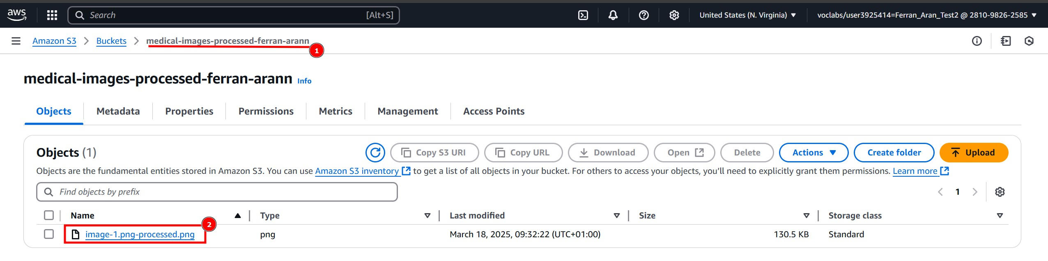
Step 3: Add a trigger to the lambda function
Once again click on Deploy to save the changes, then go to the S3 bucket
medical-images-raw-[YOUR-NAME] and upload an image to trigger the lambda function.
If everything went well you should see the same image uploaded to the processed bucket with the suﬀix -processed.png as shown below:
Figure 16: Processed image

Slide 47
Step 3: Add a trigger to the lambda function
Great so we now have a lambda function that:
Is triggered when an image is uploaded to the input bucket.
Downloads the image from the input bucket.
Uploads the image to the output bucket.
We are now going to design the code that processes the image to count the cells, and once we’re happy with it we’ll add it to the lambda function code.

Slide 48
Step 4: Write the Lambda function code
Lets open up the remote jupyter notebook on our EC2 instance that we have been using and create a new notebook. As a reminder, you can access the EC2 instance, activate the python environment (in this case we are using the sample project2 environment we created in Session 3) and start the jupyter notebook server with the following commands:
ssh -i .ssh/aws-keypair ec2-user@<your-ec2-public-ip> cd project2
source .project2-venv/bin/activate jupyter notebook --ip 0.0.0.0 --port 8888
Remember you can visit the second guide on the subject’s website to see how to access the notebook server. Link here https://hdbc-17705110-mdbs.github.io/.

Slide 49
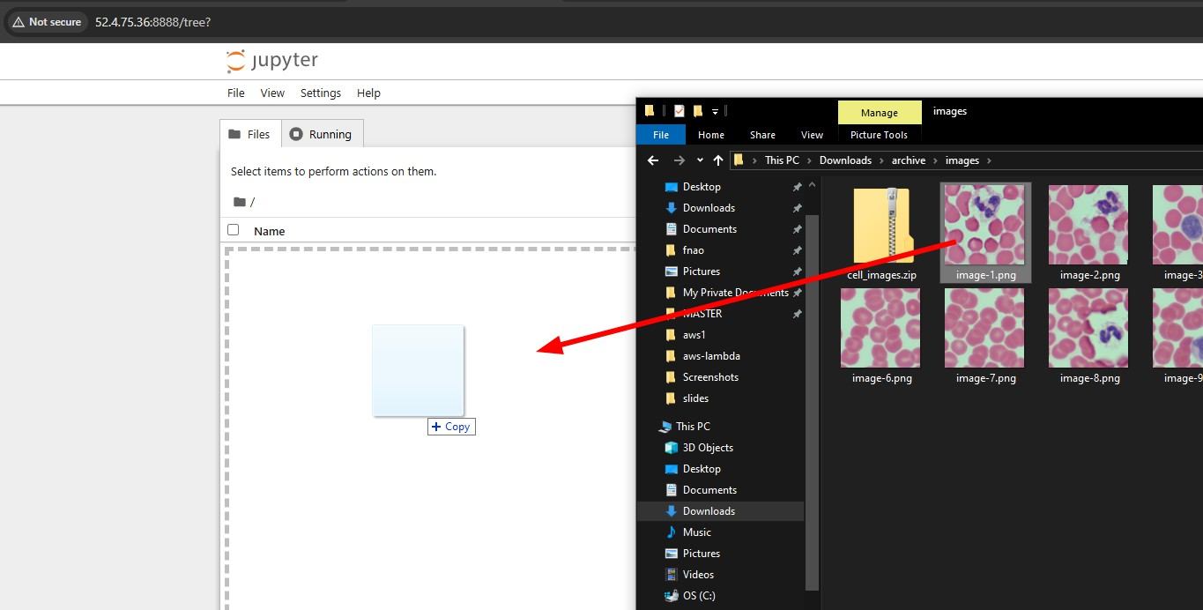
Step 4: Write the Lambda function code
With the cell images downloaded and extracted, we can now upload one of them to the notebook server from the browser to start working on the code for the Lambda function.
To upload an image to the notebook server, just drag and drop it to the browser window as shown below:
Figure 17: Upload image

Slide 50
Step 4: Write the Lambda function code
Next create a new notebook and paste the following code to install the dependencies.
!pip install matplotlib opencv-python
!sudo dnf install mesa-libGL -y
And paste the following in another cell to load the image and display it.
import cv2
import matplotlib.pyplot as plt
# Load the sample image
image_path = 'image-1.png' # Replace with your image path
image = cv2.imread(image_path)
# Display the image
plt.imshow(cv2.cvtColor(image, cv2.COLOR_BGR2RGB)) plt.show()

Slide 51
Step 4: Write the Lambda function code
Wer are now free to work on whichever code we want to process the images. By using the Jupyter notebook we can test the code and see the results before deploying it to the Lambda function. For now, trust me and copy the following code to a new cell:
# Count cells by drawing contours around them gray_image = cv2.cvtColor(image, cv2.COLOR_BGR2GRAY) adaptive_thresh = cv2.adaptiveThreshold(
gray_image, 255, cv2.ADAPTIVE_THRESH_MEAN_C,
cv2.THRESH_BINARY_INV, 65, 5
)
kernel = cv2.getStructuringElement(cv2.MORPH_ELLIPSE, (5,5))
morph_image = cv2.morphologyEx(adaptive_thresh, cv2.MORPH_OPEN, kernel, iterations=1) contours, _ = cv2.findContours(
morph_image, cv2.RETR_EXTERNAL, cv2.CHAIN_APPROX_SIMPLE
)
# Print the result
cell_count = len(contours) print(f'Cell count: {cell_count}')

Slide 52
Step 4: Write the Lambda function code
Printing the result is fine but it would be even better if we could visualize the contours drawn around the cells. To do so, we can use the following code:
output_image = image.copy()
cv2.drawContours(output_image, contours, -1, (0, 255, 0), 2)
# Generate the images
fig, axes = plt.subplots(1, 2, figsize=(12, 6))
axes[0].imshow(cv2.cvtColor(image, cv2.COLOR_BGR2RGB)) axes[0].set_title('Original Image') axes[0].axis('off')
axes[1].imshow(cv2.cvtColor(output_image, cv2.COLOR_BGR2RGB)) axes[1].set_title(f'Contours (Cells: {cell_count})') axes[1].axis('off')
plt.show()

Slide 53
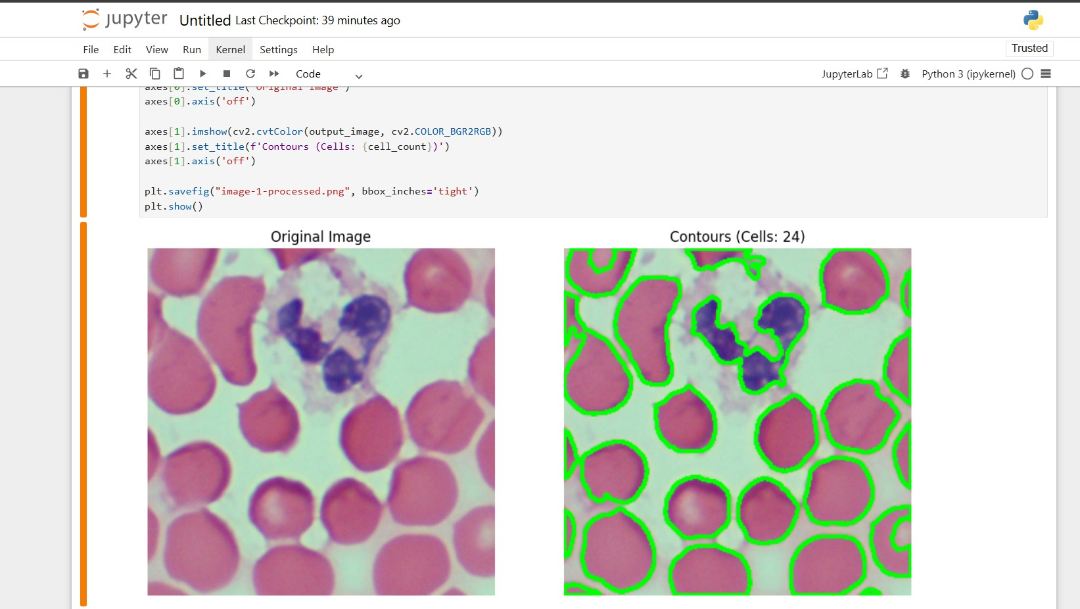
Step 4: Write the Lambda function code
The visualization should look like this:
Figure 18: Processed image

Slide 54
Step 4: Write the Lambda function code
By now our code does the following:
Load an image.
Process the image to count the cells.
Generate an image with the results.
We are now going to need to adapt this code to work in the Lambda function where it will have to read the image from the S3 bucket given its path and write the results back to another S3 bucket.

Slide 55
Step 4: Write the Lambda function code
In the AWS Console go to the Lambda service and click on the lambda function we created earlier, then scroll down to the code editor and paste the following code (note that the code takes 3 slides to fit):
import boto3
import cv2
import numpy as np
import json
import os
import urllib.parse
s3 = boto3.client('s3')
def lambda_handler(event, context):
# Extract bucket and image info from the S3 event
bucket = event['Records'][0]['s3']['bucket']['name']
key = urllib.parse.unquote_plus(event['Records'][0]['s3']['object']['key']) original_name = os.path.splitext(os.path.basename(key))[0]
download_path = f'/tmp/{os.path.basename(key)}'

Slide 56
Step 4: Write the Lambda function code
# Download and load the image from S3 s3.download_file(bucket, key, download_path) image = cv2.imread(download_path)
# Count the cells using contours
gray_image = cv2.cvtColor(image, cv2.COLOR_BGR2GRAY) adaptive_thresh = cv2.adaptiveThreshold(
gray_image, 255, cv2.ADAPTIVE_THRESH_MEAN_C,
cv2.THRESH_BINARY_INV, 65, 5
)
kernel = cv2.getStructuringElement(cv2.MORPH_ELLIPSE, (5,5))
morph_image = cv2.morphologyEx(adaptive_thresh, cv2.MORPH_OPEN, kernel, iterations=1) contours, _ = cv2.findContours(
morph_image, cv2.RETR_EXTERNAL, cv2.CHAIN_APPROX_SIMPLE
)
cell_count = len(contours)

Slide 57
Step 4: Write the Lambda function code
# Draw contours on a copy of the image
output_image = image.copy()
cv2.drawContours(output_image, contours, -1, (0, 255, 0), 2)
# Save the processed image and upload it to the "processed" bucket result_image_name = f"{original_name}-processed-{cell_count}-cells.png" result_image_path = f'/tmp/{result_image_name}' cv2.imwrite(result_image_path, output_image)
result_bucket = 'medical-images-processed-[YOUR-NAME]' # Replace with your bucket name
s3.upload_file(result_image_path, result_bucket, result_image_name)
return {
'statusCode': 200,
'body': json.dumps(f"Processed {key}, found {cell_count} cells.")
}

Slide 58
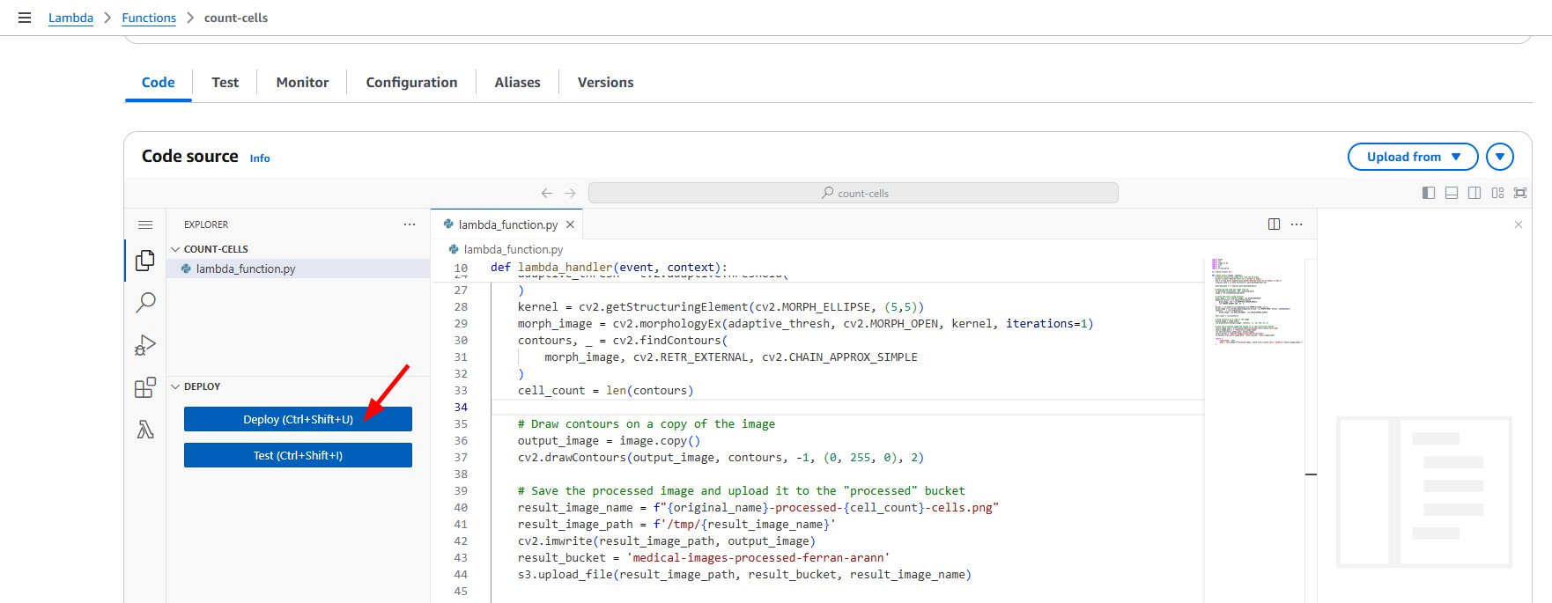
Step 4: Write the Lambda function code
Once the code is copied click on Deploy to save the changes.
Figure 19: Deploy

Slide 59
Step 5: Create and publish a Lambda layer with the dependencies
AWS Lambdas come with some python dependencies pre-installed such as boto3 (which is the library we use to write and read from S3 buckets), but we are going to need to install opencv-python to process the images since it is not included by default.
To do so, we are going to create a Lambda layer with the dependencies and attach it to the Lambda function. Think of it as a way of packaging the needed dependencies so the lambda has them available when it runs.
We are going to need a machine with AWS CLI and its credentials configured as well as Python 3.13 and zip installed. I am going to use the EC2 instance we created in the previous unit together with uv for managing python versions. AWS CLI and zip are already installed in the instance.

Slide 60
Step 5: Create and publish a Lambda layer with the dependencies
Start by creating a folder which we’ll use to build the layer and cd into it.
mkdir -p cell-count-layer/python/lib/python3.13/site-packages/ cd cell-count-layer
Now create a virtual environment with uv and install the dependencies.
uv venv --seed --python 3.13 .cell-count-venv source .cell-count-venv/bin/activate
pip install opencv-python-headless -t python/lib/python3.13/site-packages

Slide 61
Step 5: Create and publish a Lambda layer with the dependencies
Now we are going to zip the contents of the folder to create the layer.
zip -r opencv.zip python
We’ll need to create a bucket where we upload the layer so we can then import it to Lambda layers. You can use the AWS Console on your browser as we’ve done before or use the following command where you have to replace [YOUR-NAME] with your name:
aws s3 mb s3://layers-bucket-[YOUR-NAME]

Slide 62
Step 5: Create and publish a Lambda layer with the dependencies
Now publish the layer to the bucket.
aws s3 cp opencv.zip s3://layers-bucket-[YOUR-NAME]/
And finally, we are going to import the layer from the bucket to the Lambda layers.
aws lambda publish-layer-version \
--layer-name opencv \
--content S3Bucket=layers-bucket-[YOUR-NAME],S3Key=opencv.zip \
--compatible-runtimes python3.13
Let’s now see how to add this layer to our lambda.

Slide 63
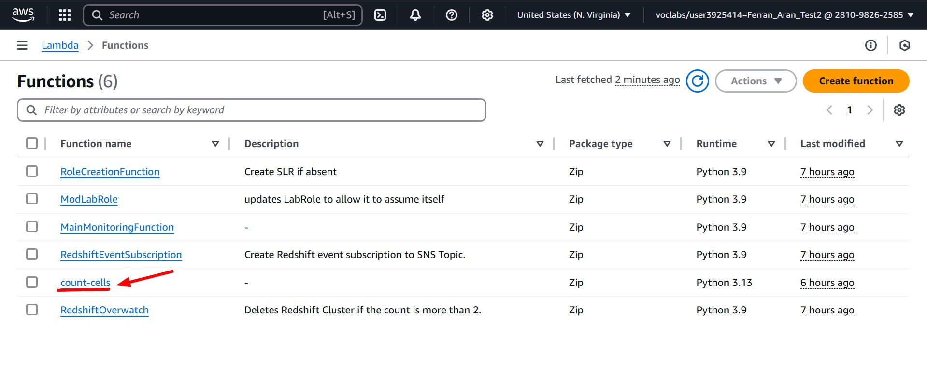
Step 5: Create and publish a Lambda layer with the dependencies
Visit the Lambda service on the AWS Console and look for the function we have been working on. Click on it.
Figure 20: Lambda layer

Slide 64
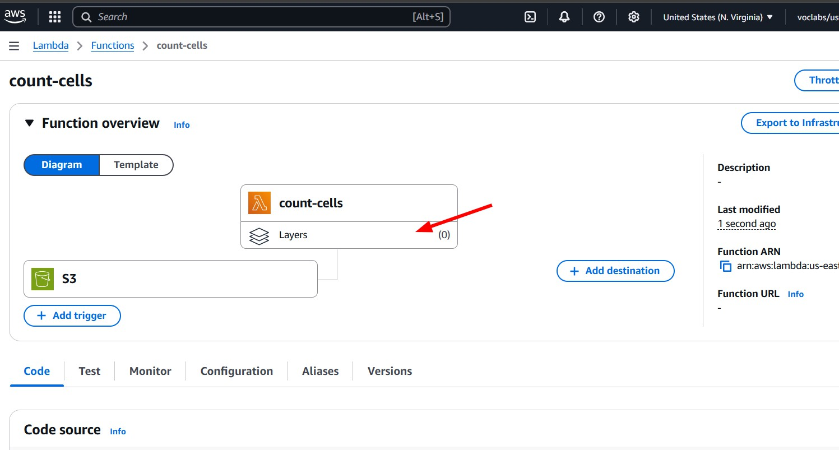
Step 5: Create and publish a Lambda layer with the dependencies
Click on the Layers section below the function’s name.
Figure 21: Lambda layer

Slide 65
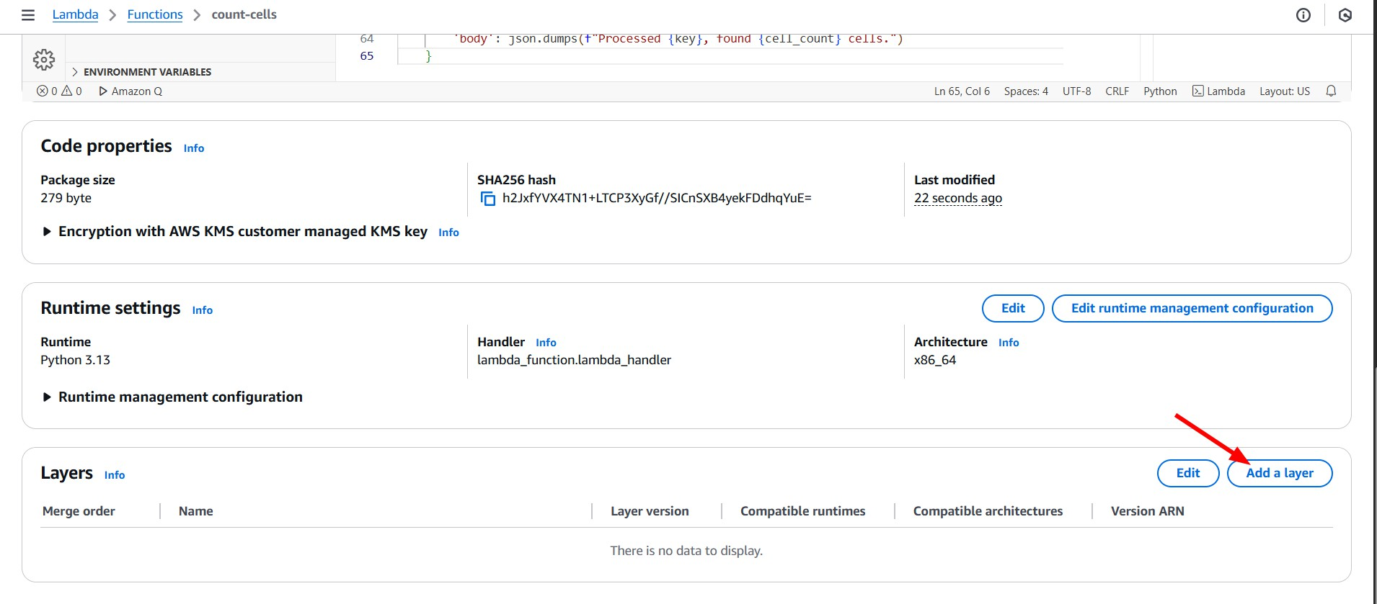
Step 5: Create and publish a Lambda layer with the dependencies
Click on Add a layer.
Figure 22: Lambda layer

Slide 66
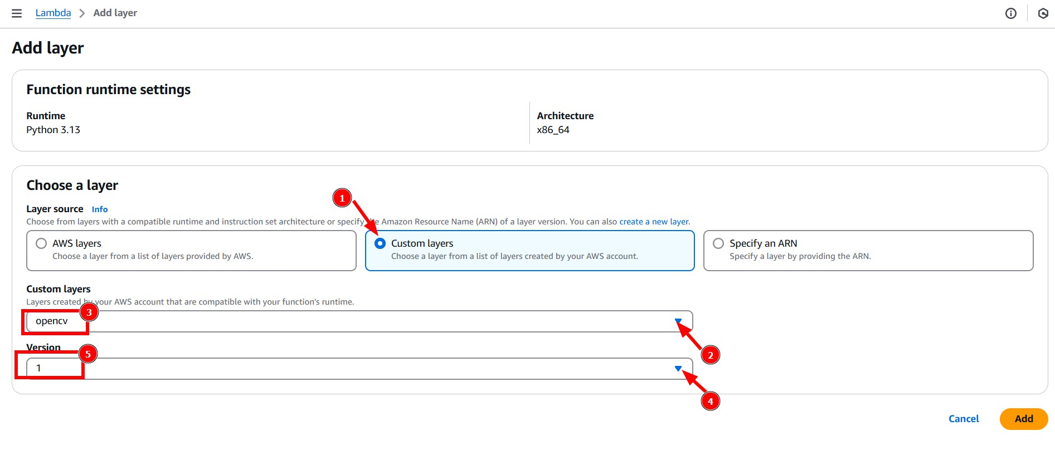
Step 5: Create and publish a Lambda layer with the dependencies
Click on Custom layers and select the layer we just created. Finally click on Add.
Figure 23: Lambda layer

Slide 67
Step 6: Upload the images to the input bucket
Remember the cell images can be found on the virtual campus https://campusvirtual.urv.cat/ or on the subject’s website https://hdbc-17705110-mdbs.github.io.
To upload them to the S3 bucket, we could do so by using the AWS Console as we did before, but this time we are going to use the AWS CLI to do it.
aws s3 cp ./cell_images s3://medical-images-raw-[YOUR-NAME]/ --recursive
The next slide contains a screenshot of the general steps to download, extract and upload the images to the S3 bucket.

Slide 68
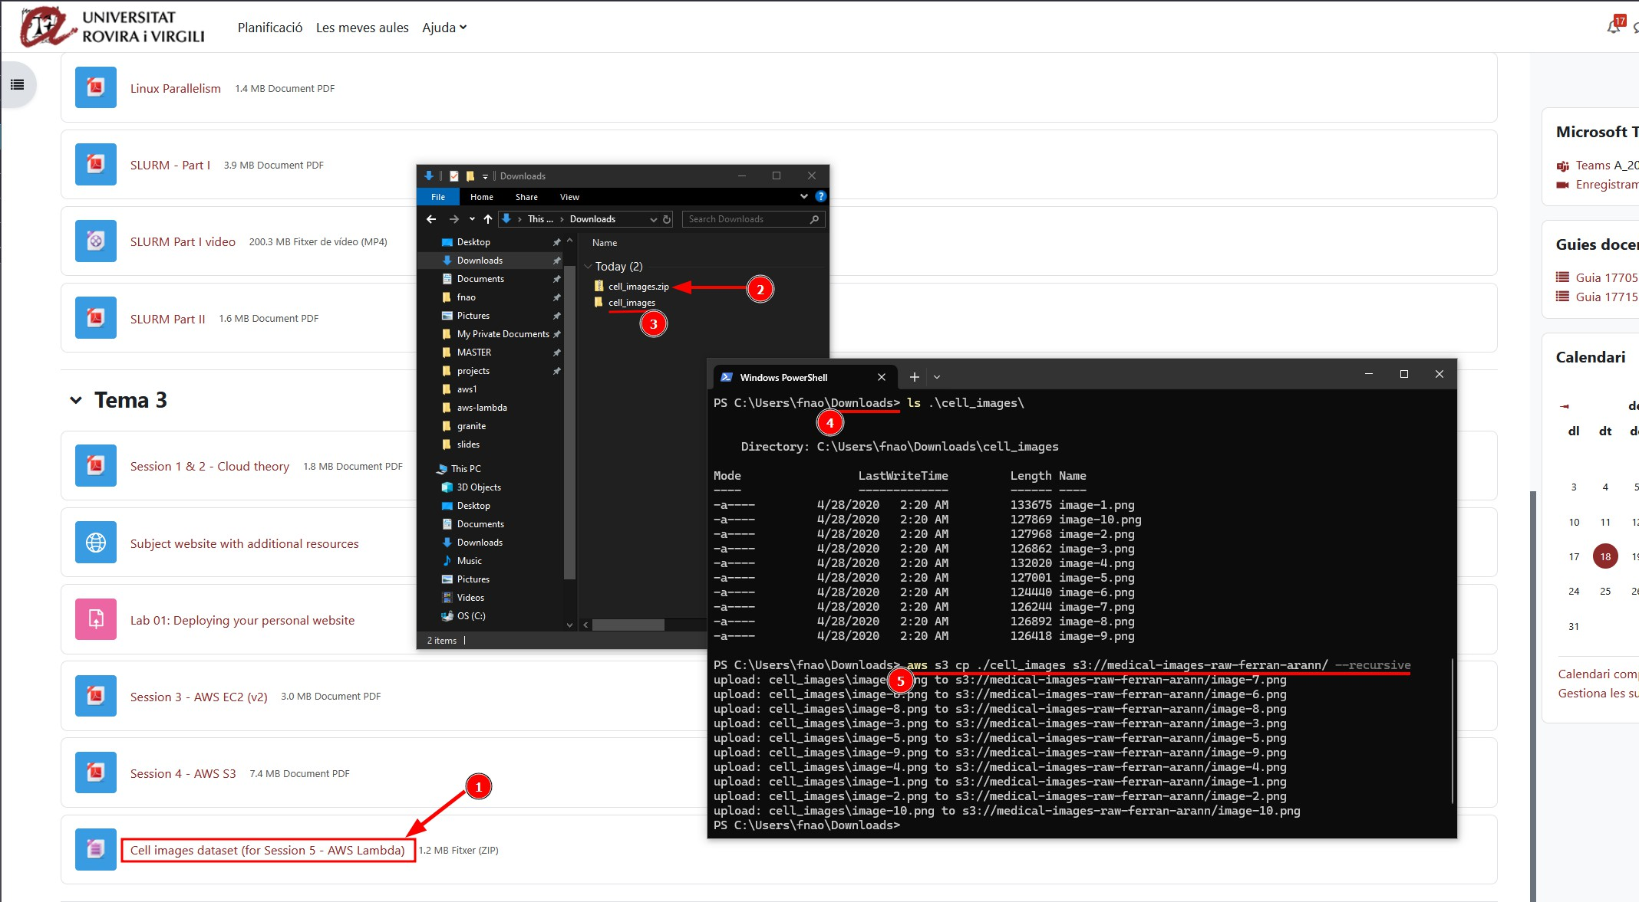
Step 6: Upload the images to the input bucket
Figure 24: Upload images

Slide 69
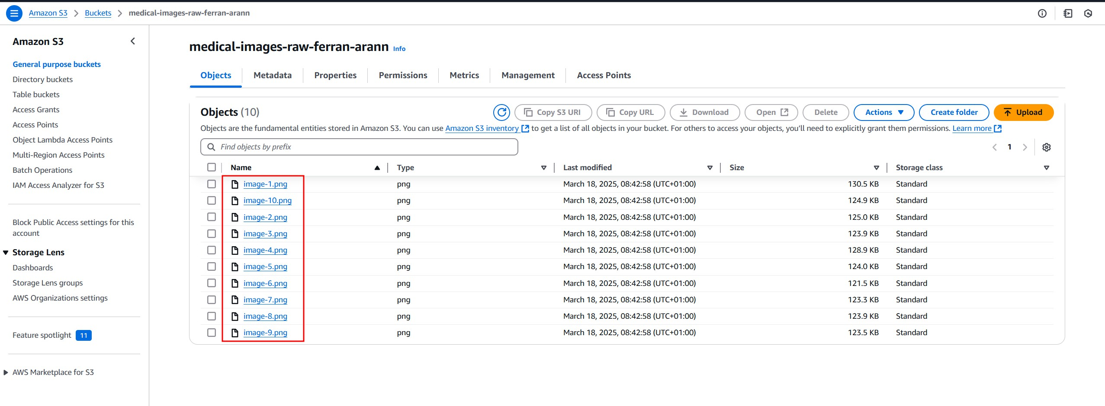
Step 6: Upload the images to the input bucket
If we check on the AWS Console the input bucket medical-images-raw-[YOUR-NAME] we should see the images uploaded.
Figure 25: Uploaded images

Slide 70
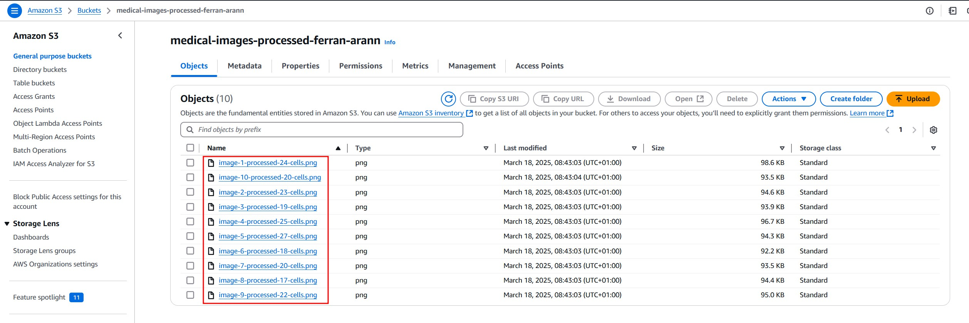
Step 7: Check the results in the output bucket and verify the Lambda logs
If we’ve done everything correctly, a Lambda function should have been triggered for each image uploaded to the input bucket, and the processed images should be in the output bucket.
If we check S3 bucket medical-images-processed-[YOUR-NAME] we should see something like this:
Figure 26: Processed images

Slide 71
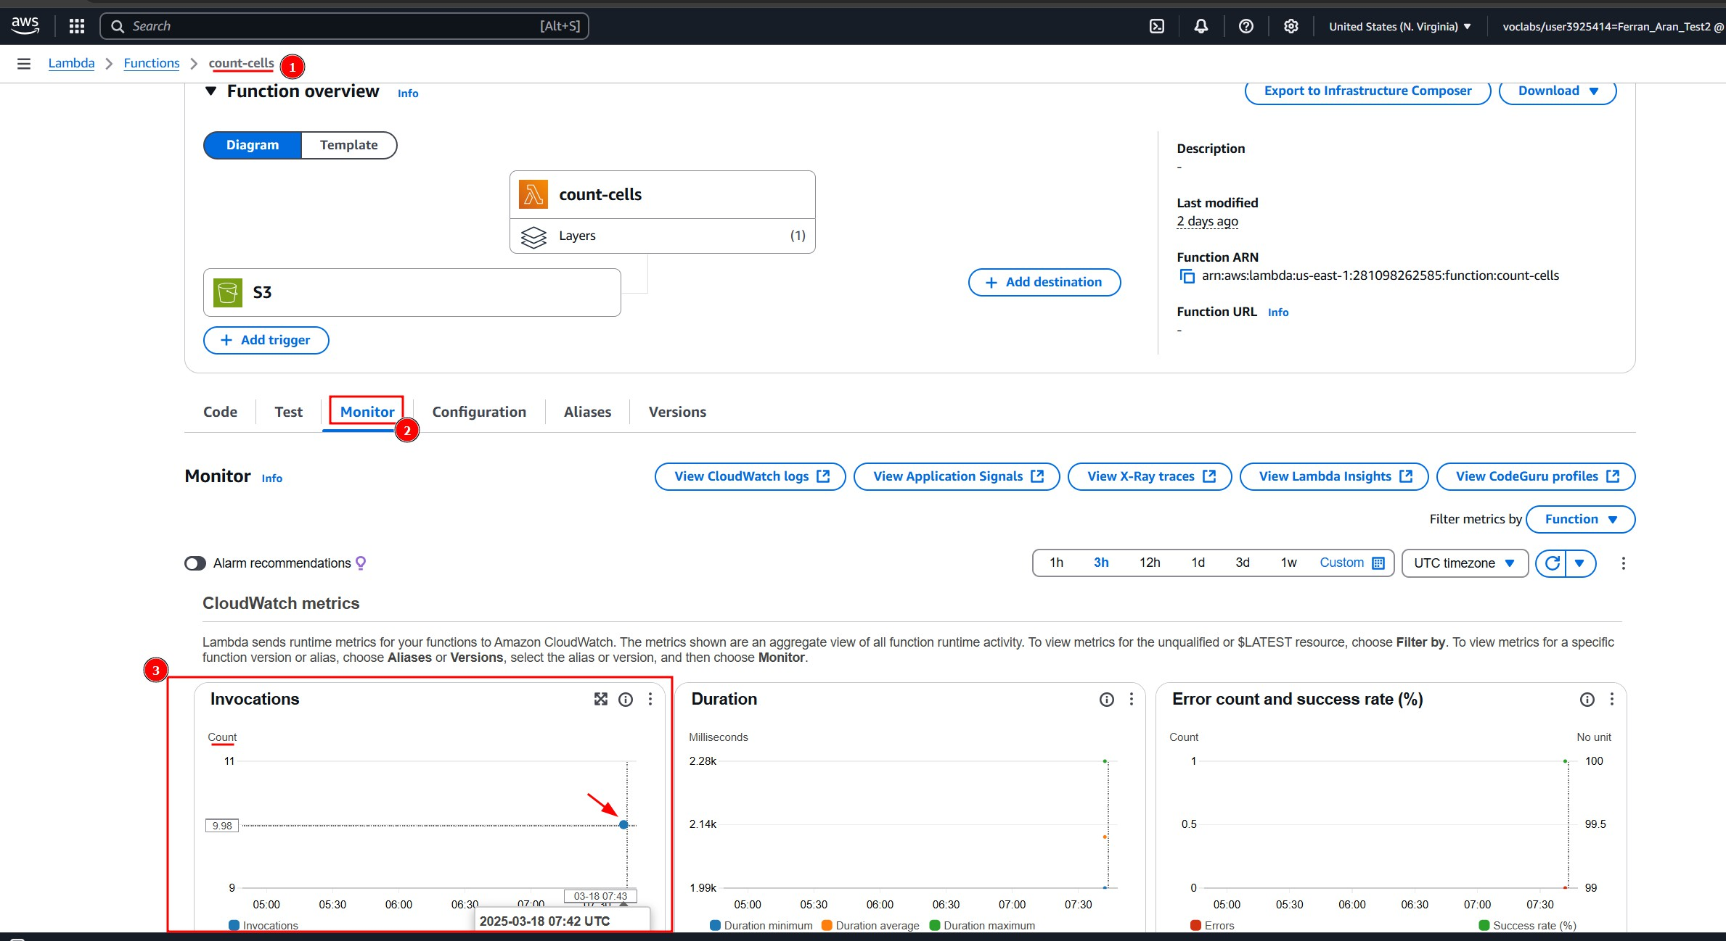
Step 7: Check the results in the output bucket and verify the Lambda logs
And if we go back to our lambda and click on Monitoring. We should see a plot named
Invocations that shows the number of times the lambda has been triggered.
Figure 27: Lambda invocations

Slide 72
Step 7: Check the results in the output bucket and verify the Lambda logs
We could also click on View logs in CloudWatch to see the logs of the lambda function as we did earlier.
Figure 28: Lambda logs

Slide 73
Recap

Slide 74
Recap
AWS Lambda is a serverless computing service that runs code in response to events.

Slide 75
Recap
AWS Lambda is a serverless computing service that runs code in response to events.
Lambda functions are triggered by events from various sources, such as S3, API Gateway, and CloudWatch.

Slide 76
Recap
AWS Lambda is a serverless computing service that runs code in response to events.
Lambda functions are triggered by events from various sources, such as S3, API Gateway, and CloudWatch.
Lambda functions can be used for real-time data processing, data aggregation, data validation, and image processing in healthcare applications.

